Slide 1
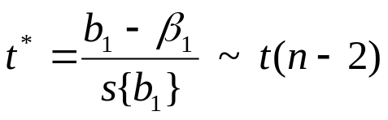
Inferences on β₁
Recall that
We use this t distribution of our test statistic to do hypothesis tests.
What value do we use for β₁ in this statistic and why?
If we want to show there is a linear association between X and Y, what are our hypotheses?

Slide 2
Inferences on β₁
Consider the Toluca example. We want to show that there is a linear relationship between work hours and lot size. Our hypotheses are:
H_{o}: β₁ = 0 vs H_{a}: β₁ ≠ 0.
Recall, that our 95% CI for β₁ is (2.85, 4.29). Will our hypothesis test be significant?
In general, a (1-α)100% confidence interval for θ contains all the values of θ_{o} such that H_{o} : θ = θ_{o} would fail to be rejected with a significance level of α.

Slide 3
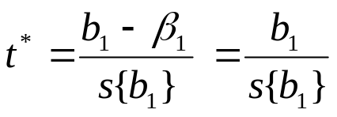
Inferences on β₁
Since our 95% confidence interval for β₁ does not contain 0, we would not fail to reject H_{o}: β₁ = 0, with α=.05. That is, we would reject this hypothesis.
To test this, we use our statistic t*
with the decision rule
If |t*| ≤ t(1-α/2;n-2) fail to reject H_{o}
If |t*| ≥ t(1-α/2;n-2) reject H_{o}

Slide 4
Inferences on β₁
In the Toluca example, we have t(.975,23) = 2.069.
| t* | = |(3.5702 – 0)/.347| = 10.29
Since 10.29 ≥ 2.069, we reject the null hypothesis and conclude that β₁ does not equal 0.
Thus we rejected that there is no linear relationship between lot size and the number of work hours.
SAS (Betas)

Slide 5
Inferences on β₁
If the analyst wanted to establish that lot size has a positive effect on hours worked, then a one-sided test would be used. Thus, we test
H_{o}: β₁ ≤ 0 vs H_{a}: β₁ > 0.
The test statistic t* remains the same but now the decision rule is
If t* ≤ t(1-α;n-2) fail to reject H_{o}
If t* ≥ t(1-α;n-2) reject H_{o}
Note, t(1-α;n-2) is 1.714. Thus we reject for t* > 1.714. For the two-sided test, we rejected for |t*| > 2.069, which is less likely.
If we expect β₁ to really be positive, the one-sided test has more power.

Slide 6

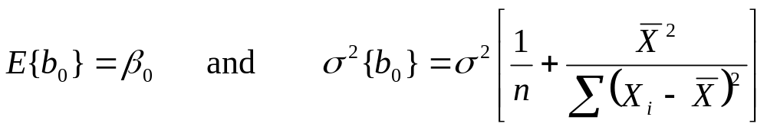
Inferences on β₀
The point estimator of β₀ is b₀ which can be found by
We have that
We also have that b₀ is normally distributed. This follows from the fact that b₀ is also a linear combination of the Y_{i}.

Slide 7
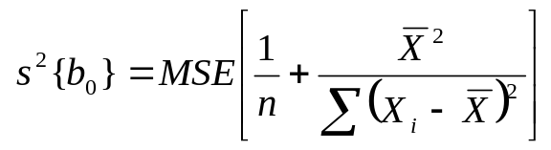
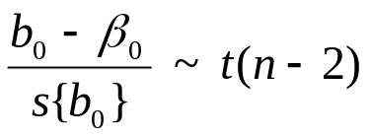
Inferences on β₀
As with b₁, since we do not know the true value of σ², we replace it in the formula of the variance of b₀ with the MSE.
To estimate the standard deviation, we use the positive square root, s{b₀}.
Thus
The degrees of freedom are n-2 since we estimate β₀ and β₁.

Slide 8

Inferences on β₀
A (1-α)100% confidence interval for β₀ is
When the scope of the model includes X=0, β₀ gives the mean of the probability distribution of Y at X=0.
When the scope of the model does not cover X=0, β₀ does not have any particular meaning as a separate term in the regression model.
For the Toluca example, β₀ does not necessarily provide information about the setup cost when X=0, since we are not certain if this model is appropriate when extended to X=0 since the range of X in the data started at 20. (SAS Betas)

Slide 9
Considerations on Inferences
If the probability distribution of the error terms is slightly non-normal, the sampling distributions of b₀ and b₁ will be approximately normal.
If the probability distributions of the error terms is far from normal, the sampling distributions of b₀ and b₁ will be asymptotically normal.
That is, the sampling distributions of b₀ and b₁ will approach normality as the sample size gets large.
Thus, for sufficiently large samples, our confidence intervals and hypothesis tests are still valid even if the probability distributions of the error terms is far from normal.

Slide 10
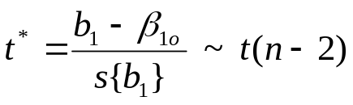
Considerations on Inferences
The power of tests on β₀ and β₁ can be obtained from Table B.5 in the appendix. Consider the general test concerning β₁:
H_{o}: β₁ = β_{1o} vs H_{a}: β₁ ≠ β_{1o}
To test this we use t* such that
The decision rule is,
if |t*| ≤ t(1-α/2;n-2) fail to reject H_{o}
if |t*| ≥ t(1-α/2;n-2) reject H_{o}

Slide 11
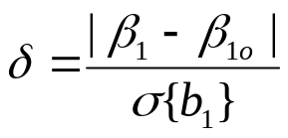

Considerations on Inferences
We define δ as the noncentrality measure, a measure of how far the true value of β₁ is from the null value β_{1o}, in terms of standard deviations.
The power of this test is the probability that we reject the null hypothesis when the null hypothesis is false.
Table B.5 gives the power for two-sided t tests for α=.05 and α=.01 for various degrees of freedom.

Slide 12
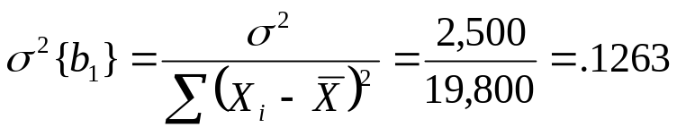
Considerations on Inferences
For example, suppose in the Toluca example, we are using β_{1o} equals 0, so that we are testing
H_{o}: β₁ = 0 vs H_{a}: β₁ ≠ 0 .
Suppose we wish to know the power of an α=.05 test when the true β₁ is really 1.5.
To do this, we need to know σ² in order to determine σ²(b₁). Lets assume that σ² = 2500. Then σ²{b₁} is

Slide 13
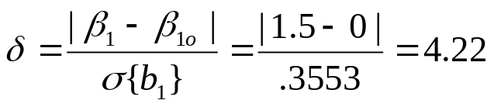
Considerations on Inferences
Taking the square root gives us that σ{b₁} is .3553 and thus
Note, there are n-2 = 25-2=23 df associated with this test.
We then use table 5 to get the power. Since the table only gives the power for whole digits of δ, we will find the power for δ=4 and for δ=5.
We will then interpolate linearly to estimate the power for δ=4.22

Slide 14
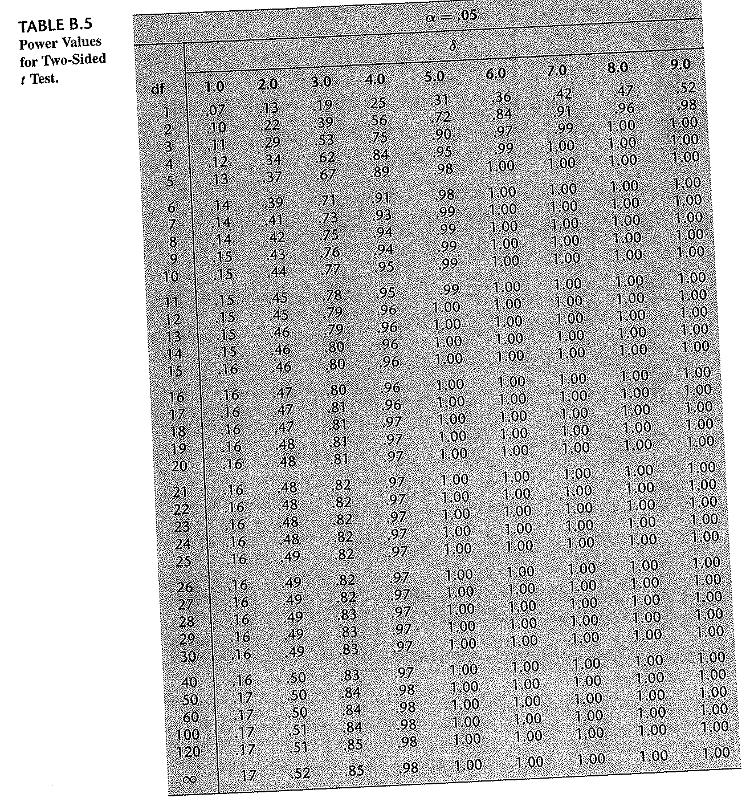
Considerations on Inferences

Slide 15
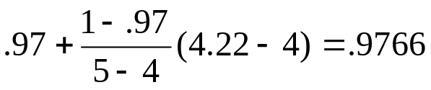
Considerations on Inferences
For δ=4, the power is .97 and for δ=5, the power is 1. We estimate the power for δ=4.22 as (intercept + slope times amount of change)
Thus, if the true β₁ were really 1.5, there would be about a .98 probability of rejecting the null for a sample size of 25, with this assumed variance.
Note, the larger δ, the more power there is. This can be seen in the two components of δ.

Slide 16
Considerations on Inferences
For the numerator, the larger the difference between the true β₁ and the hypothesized β₁, the larger δ is.
It is intuitive that there would be more power rejecting a null that β₁ is 0 when the true β₁ is 100 than when the true β₁ is 1.
In the denominator, the smaller the variance of b₁, the larger δ is.
When the variance of our estimators are smaller, they are more precise and our tests have more power.

Slide 17
Considerations on Inferences
Also note, to calculate the power, we need to make assumptions about the value of the true β₁ and σ².
These values can be estimated from pilot data.
Values that are meaningful to research can be used.
It is also possible to simply use a value of δ that is meaningful. Such as, a difference of .5 standard deviations may be meaningful so δ=.5 could be used.

Slide 18
Considerations on Inferences
The powers for the table with α=.05 are greater than the corresponding powers for the table with α=.01.
For example, for δ=4 with 23 degrees of freedom, for α=.01, the power is .87 as compared to .97 for α=.05.
The smaller α, the less likely a test is to reject and thus the less power our tests have.
Note, to calculate power for a one-sided test with significance level α, use the (α*2) table. So for a one-sided test with significance level .05, one would use a table for α=.1.

